Slide 1
Product Strategy & Planning
Rahul Mohandas

Slide 2
S1-25_SEZG508 Product Strategy & Planning
Session #3 – Saturday, 9 Aug 2025
Rahul Mohandas

Slide 3
Discussion On Week 2
Value Exchange
Costs
Product as an investment
Notes:
Talk about your products

Slide 4
What is Value?
Functional
Emotional
Economic
Makes Money
Saves Money
Convenience
More Choice
How I Feel
How Others Feel

Slide 5
Discussion Topics
Discussion – What is the value your product is delivering?
Industry Analysis Frameworks
Porter’s Generic Strategies
PESTLE Analysis
Porter’s 5 Force analysis

Slide 6

Strategy: What Would you Consider?
This Photo by Unknown Author is licensed under CC BY-SA-NC
Notes:
Reach your goal? Does the goal stay the same all the time?
Gives you a plan – Proactive Vs Reactive
Unique value better than “BETTER” value
Sustained competitive advantage
Why did Apple decide to make their own chips M1/ A1 etc? Was it a strategic move?
The best way to predict the future is to create it!

Slide 7
Porter’s Generic Strategies

Slide 8
3 Generic Strategies
Cost Leadership
Differentiation
Focus

Slide 9
Focus
Objective – Focus on a specific niche segment
Benefits – Meet the unique needs better than anyone else
Notes:
Amazon when they started
Do you have the discipline to say NO?
Focus
Definition: Concentrating on a niche market and serving it better than competitors who target broader audiences.
Two Variants:
Cost Focus: Be the lowest-cost provider in a niche (e.g., low-cost carriers targeting specific routes).
Differentiation Focus: Offer a unique product for a narrow segment (e.g., luxury watchmakers like Patek Philippe).
Examples:
Amazon early days with Technology Books, Dollar Shave Club (direct-to-consumer razors).
Key Enablers:
Sharp segmentation and targeting
Deep understanding of niche needs
Tailored marketing and operations

Slide 10
Differentiation
Objective – To offer a unique product or service
Benefits – Makes it hard to copy
Notes:
AirBnB
Amazon when they started
Differentiation
Definition: Offering products/services that are perceived as unique and valuable, allowing you to charge a premium.
How it Works:
Focus on brand, innovation, design, service, or other attributes customers value.
Price sensitivity reduces because customers see fewer substitutes.
Examples:
Apple (design + ecosystem), Amazon early days (book comes to you), AirBnB (stay in host homes).
Key Enablers:
Strong R&D and product design
Marketing and brand building
Deep customer insight

Slide 11
Cost Leadership
Objective: To be the lowest cost producer in the industry
Benefits: low cost can improve margins or help offer lower prices
Notes:
Amazon
Booking.com
- what do you need to be able to get cost leadership – economies of scale/ technology & process innovation/
Can you start off with a cost leadership strategy? Any Indian examples that pulled this off? (Jio)
1. Cost Leadership
Definition: Becoming the lowest-cost producer in your industry while maintaining acceptable quality.
How it Works:
Achieve scale economies, efficient operations, and tight cost control.
Pass savings to customers through lower prices (to win market share) or keep prices stable but enjoy higher margins.
Examples:
Walmart (retail), Southwest Airlines (air travel), Xiaomi (smartphones in early years).
Key Enablers:
Large-scale production
Supply chain mastery
Lean processes and technology automation

Slide 12
Key Considerations for Practitioners
Context shapes strategy choice
Strategy could change over time
Combination of one or more of the generic strategies
Customer Segmentation is Core
Execution matters more than labels!!!
The Lifecycle Effect
Notes:
Shifts Often Require Capability Transitions
Moving from differentiation to cost leadership (like Amazon) isn’t just a pricing change — it often requires re-architecting operations, culture, and even leadership mindset.
Customer Segmentation is Core
“Focus” is not simply “small market” — it’s a deliberate choice of who not to serve. Even cost leadership and differentiation benefit from sharp customer clarity.
The Lifecycle Effect
Product and market maturity stages influence which strategy makes sense. New markets often reward differentiation; mature, commoditized markets reward cost leadership.

Slide 13
PESTLE Analysis

Slide 14
PESTLE?
Political
Economic
Social
Technological
Legal
Environmental
Read more: http://pestleanalysis.com/

Slide 15
Political
What is the country’s political situation, and how can it affect the industry?
Geopolitics
Political divides
Policies
Notes:
Tariffs!!!!
Data hosting
Lobbying to impact policy - MNP?
DEI teams

Slide 16
Economic
What are the prevalent economic factors?
Economic Growth
Inflation
Interest Rates
Disposable Income
Read : Link to Economic Times
Notes:
Purchasing power parity and country specific pricing
Mens underwear and the state of the economy - https://economictimes.indiatimes.com/prime/money-and-markets/mens-underwear-sales-are-falling-should-indian-economy-prepare-for-a-below-the-belt-jolt/primearticleshow/98254338.cms
Lipstick sales during depression

Slide 17
Social
What are the social trends and its impact?
Cultural Trends
Demographics
Cristiano Ronaldo – https://youtu.be/x2ZLS1V3iMw?si=QiE0URadkljPosZQ
Notes:
Ads going wrong because of the social environment
Aspirations, Younger population – sales of cars with sunroof.
House purchasing age – late 40s to mid 20s to millenials
Cristiano Ronaldo – coke vs water. Coke lost $4bn in market cap!- https://youtu.be/x2ZLS1V3iMw?si=QiE0URadkljPosZQ
Jumbotron ☺

Slide 18
Technological
What are emerging technology trends and how can it affect the market?
Innovation
Awareness
Notes:
Application of new technology to solve problems better – usage of GenAI? How did music distribution change over the years? What about movies?
- process/ distribution/ sourcing
Are customers aware of possibilities?

Slide 19
Legal
What is the legal structure and is it likely to change?
Labor
Safety
Privacy
Tax
Notes:
Labor laws – mental health – Merchant Risk monitoring – employee exposure to potentially illegal websites
Facebook again! Teen safety
Privacy concerns – move from whatsapp to signal/ telegram
Copyright – music streaming rights in different countries
Tax structures - GST?
– where do you base your company HQ?

Slide 20
Environmental
What are the environmental concerns for the industry?
Sustainability
Carbon Footprint
Notes:
Patagonia
EV market
Move from paper to e-paper

Slide 21
Porters 5 Force Analysis

Slide 22
Porters 5 Force Model
Threat of New Entrants
Competitive Rivalry
Supplier Power
Buyer Power
Threat of Substitutes
Notes:
Industry analysis

Slide 23

Competitive Rivalry
# of competitors
Industry trends
Quality differences
Switching costs
Loyalty
Exit barrier
…

Slide 24

Supplier Power
# of suppliers
Size of suppliers
Uniqueness of supplier product
Ability to substitute suppliers product
…

Slide 25

Buyer Power
# of buyers
Size of buyer
Size of orders
Are they organized
Price sensitivity
Switching cost
Ability to substitute
Information available
…

Slide 26

Threat of Substitutes
# of substitutes
Relative price performance of substitutes
Perceived level of differences
Switching costs
…

Slide 27
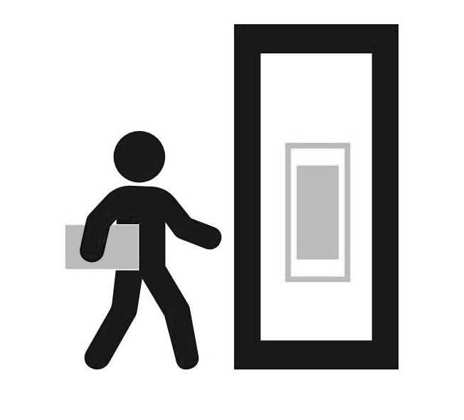
Threat of New Entrants
Entry barrier
Brand loyalty
Capital requirements
Policies
Capabilities required – People/ Distribution/ Experience
Access to suppliers and distribution channels
Switching costs
…

Slide 28

Let’s Try…
Netflix Content Strategy -> Original & Exclusive
Do a 5 force analysis for Netflix to identify the forces and opportunities

Slide 29
Over to the Miro board

Slide 30
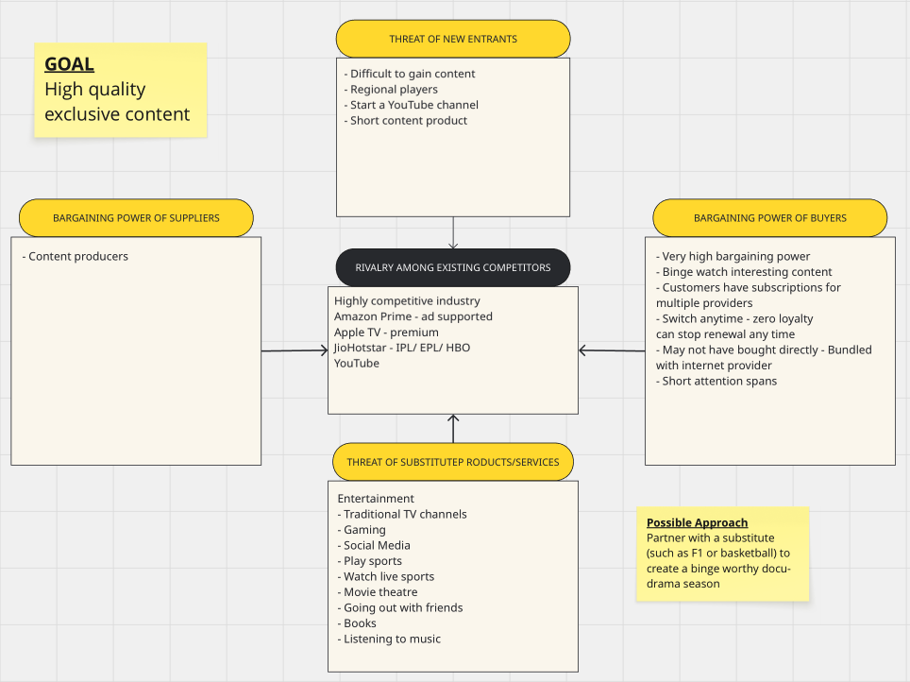

Slide 31
Next Week
Your Take On Week 3
Category definition
Competitive benchmarking
Value flow
Co-opetition
Scenario planning

Slide 32

Questions

